Slide 1

FEATURED DEVELOPERS
https://featureddeveloper.herokuapp.com/#/home
SEC 03-03
KEERTHI MULI
RASAGNA REDDY BANDA
JAYA KUMAR SAGA
SHIVA RAM KOTHAPALLY

Slide 2
Overview
One place for all the developer's information in the class.
Anyone can use this app by using theirs GitHub.
Can do CRUD operations.
PWA

Slide 3




Stack
Java
Vue.js
Heroku Postgres SQL
Heroku (server)

Slide 4
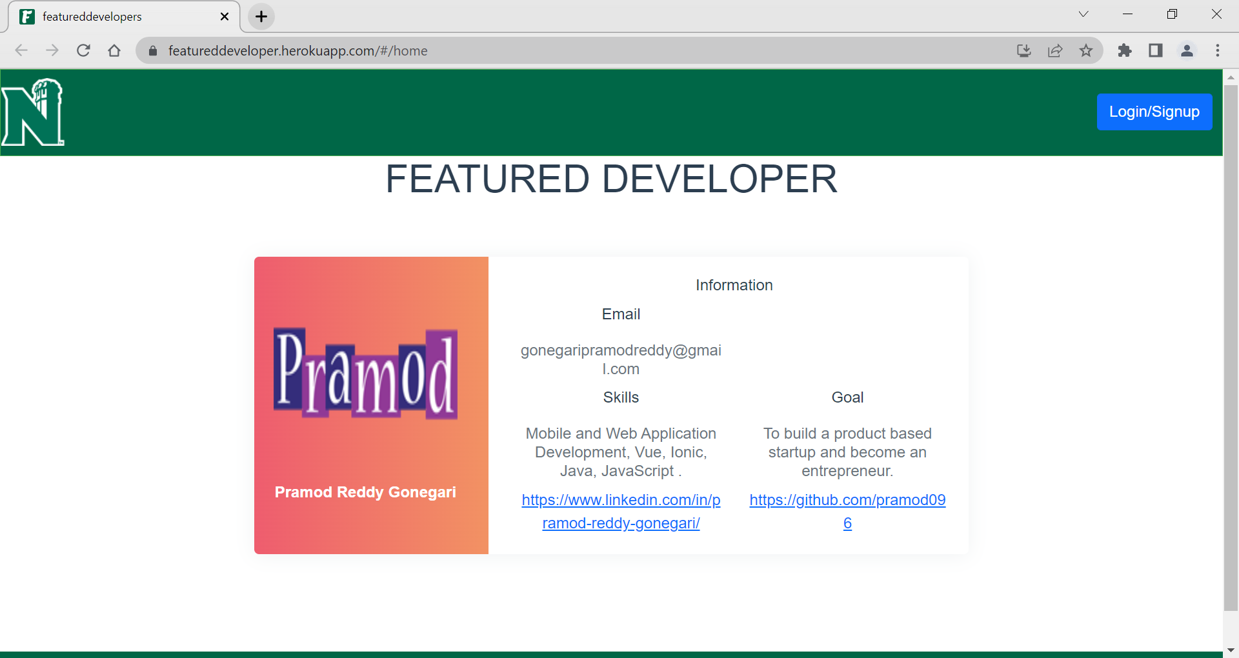
Homepage

Slide 5
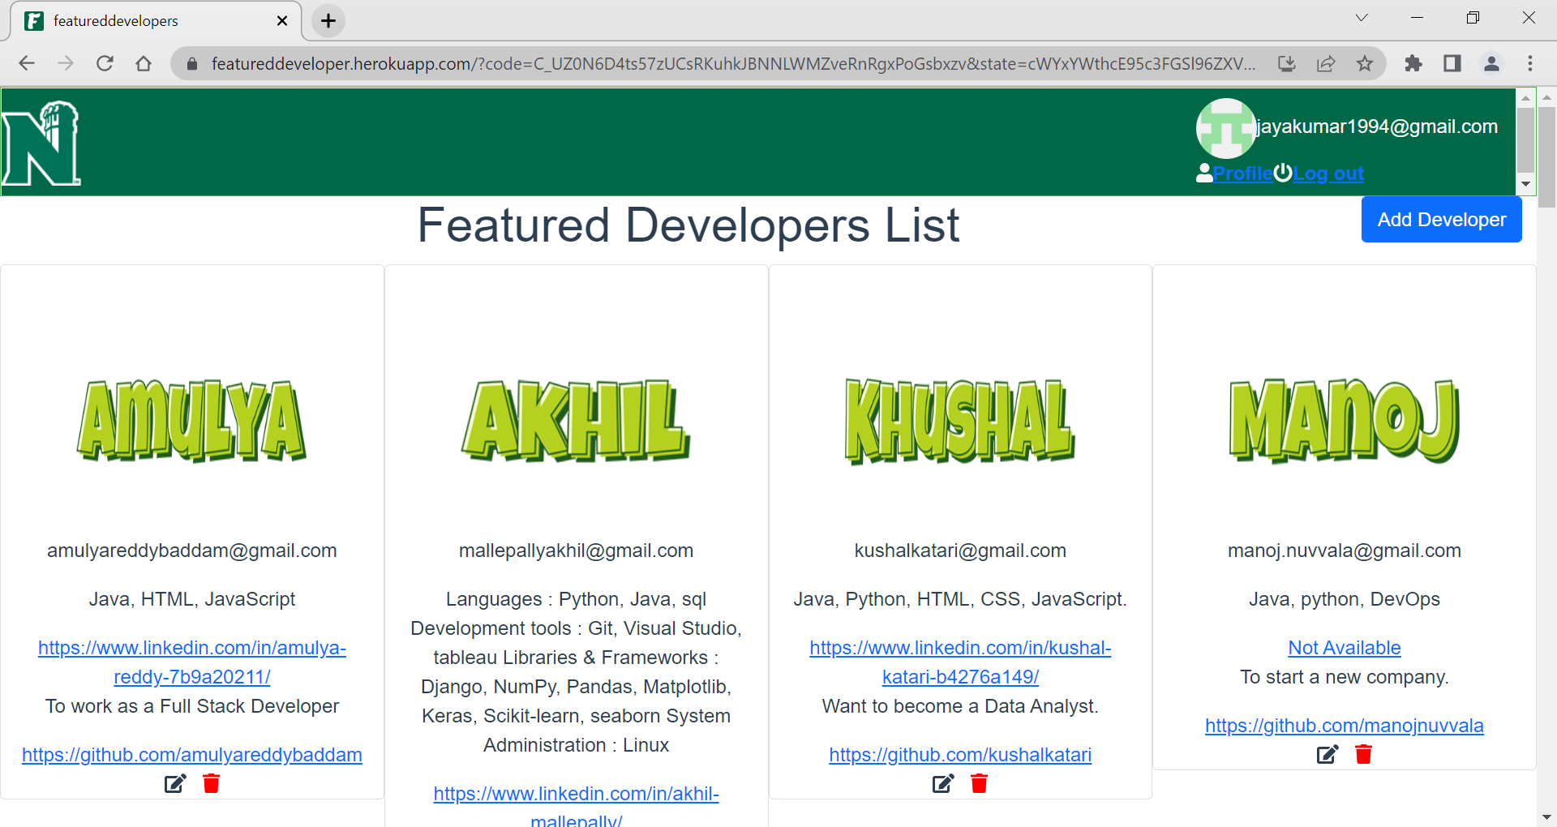
View All

Slide 6
Tools Documents Links
Proposal
Codacy
Snyk
Swagger
Javadoc
Code coverage Report

Slide 7


